Slide 1
22C:19 Discrete Math Graphs
Spring 2014
Sukumar Ghosh

Slide 2
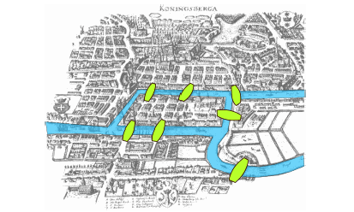
Seven Bridges of K⍥nigsberg
Is it possible to walk along a route that cross each bridge exactly once?

Slide 3
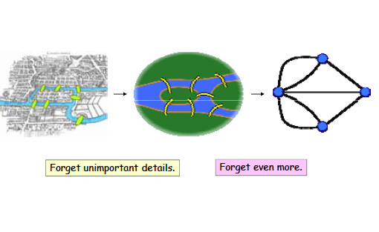
Seven Bridges of K⍥nigsberg

Slide 4
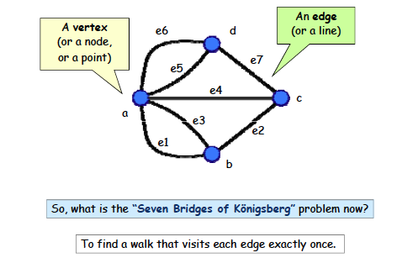
A Graph

Slide 5
What is a Graph
A graph G = (V, E) consists of V, a nonempty set of vertices
(or nodes) and E, a set of edges. Each edge connects a pair
of nodes that are called its endpoints.
Graphs are widely used to model various systems in the
real world

Slide 6
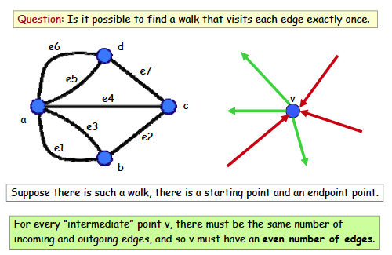
Back to the Bridges of K⍥nigsberg

Slide 7
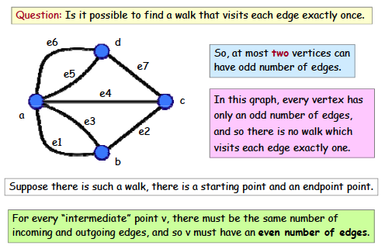
Euler’s solution

Slide 8
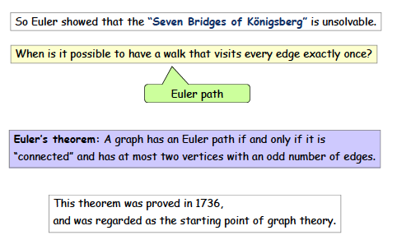
Euler path

Slide 9
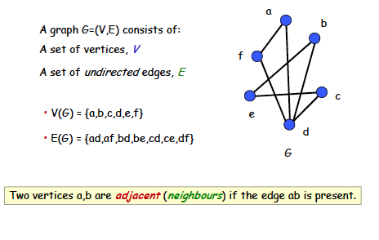
Simple graph

Slide 10
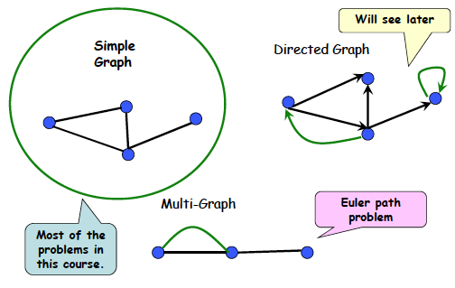
Types of graph

Slide 11
Definitions
At most one edge between a pair of nodes
Multiple edges between some pair of nodes
Simple graphs vs. multi-graphs
Undirected vs. directed graphs (digraphs)
Each edge between a pair (u, v) of nodes is directed, and represents an ordered pair

Slide 12
More examples of graphs
Each node denotes an actor or an actress, and each edge between P and Q denotes that P, Q worked together in some movie. It is an undirected graph
Hollywood graph
Web graphs
Each node denotes a web page, and each edge from page P to Q Q denotes a link on page P pointing to page Q.
It is a directed graph

Slide 13
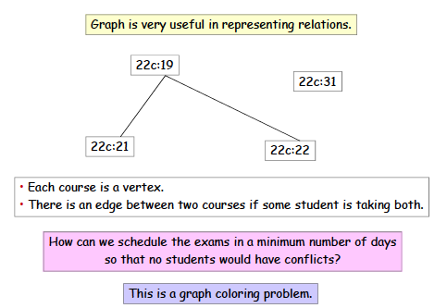
Application: Exam scheduling

Slide 14
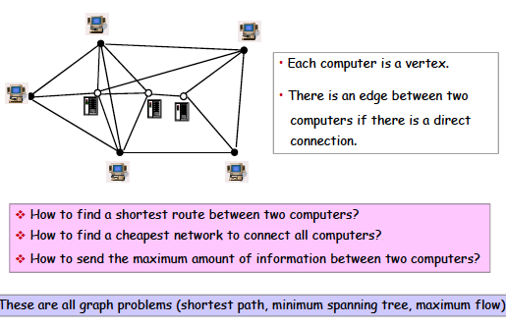
Problems in a computer network

Slide 15
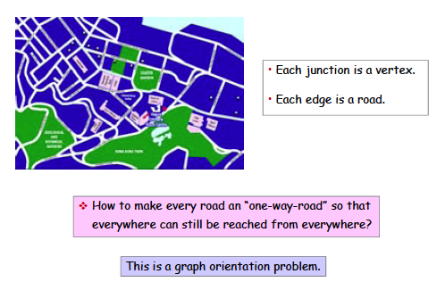
Application: graph orientation

Slide 16
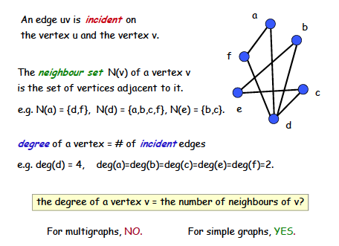
Vertex degree

Slide 17
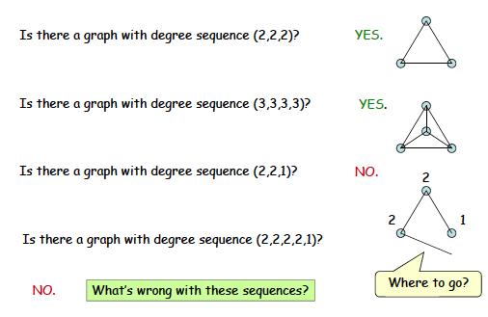
Degree sequence

Slide 18
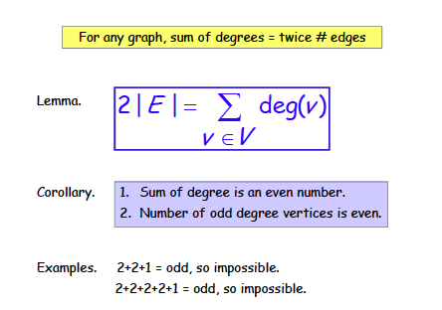
Handshaking theorem

Slide 19
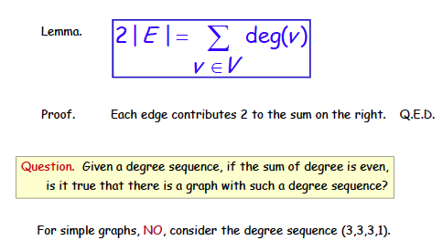
Handshaking theorem

Slide 20
A theorem
THEOREM. An undirected graph has even number
of vertices of odd degree.
Can you prove this? It should follow from the
handshaking theorem.

Slide 21
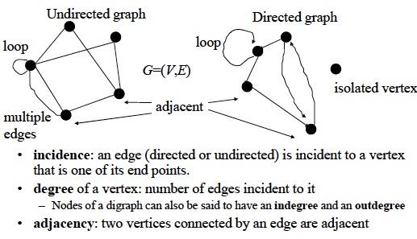
Review of basic definitions

Slide 22
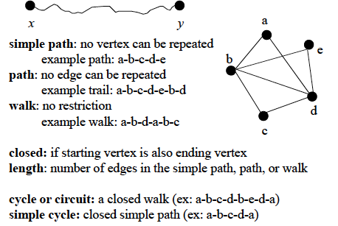
Review of basic definitions

Slide 23
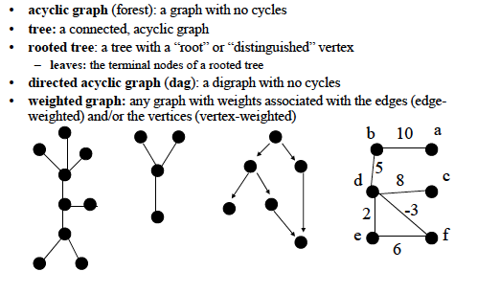
Types of graphs

Slide 24
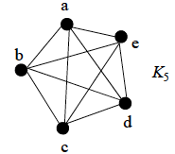
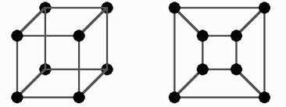
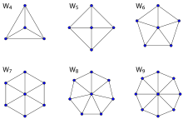
Types of graphs
The n-cube graph
n=3
Complete graph:
All vertices are adjacent
Wheel graph

Slide 25
Graph Coloring
Let G be a graph, and C be a set of colors. Graph coloring finds an assignment of colors to the different nodes of G, so that no two adjacent nodes have the same color.
The problem becomes challenging when the |C| is small.

Slide 26
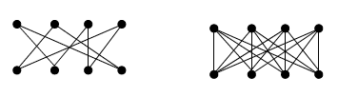
Types of graphs
Bipartite graph
A simple graph is called bipartite if its vertex set V can be
partitioned into two disjoint subsets V1 and V2, such that
every edge in the graph connects a vertex in V1 to a vertex
in V2.
Can always be colored using two colors.

Slide 27
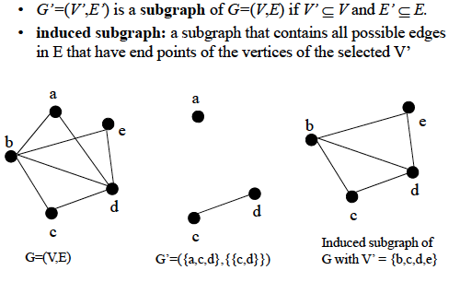
Subgraphs

Slide 28
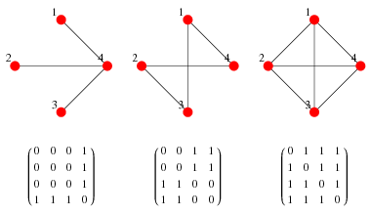
Computer representation of graphs
ADJACENCY MATRIX
(taken from Wolfram Mathworld)

Slide 29
Computer representation of graphs
ADJACENCY LIST
1
Vertex | Adjacent to
1 2 3 4 | 3, 4 3, 4 1, 2 1, 2
2
4
3
Can be represented as a linked list

Slide 30
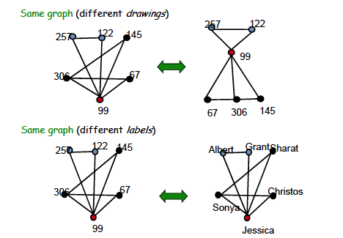
Graph isomorphism
Taken from MIT 6.042J/18.062J

Slide 31
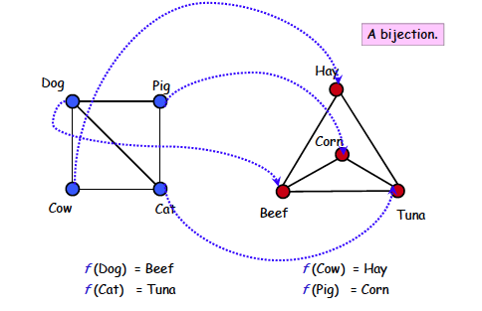
Graph isomorphism
Taken from MIT 6.042J/18.062J

Slide 32
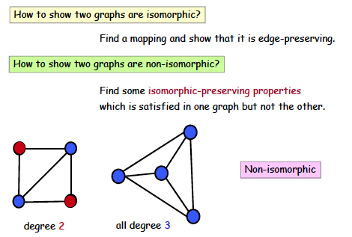
Graph isomorphism
Taken from MIT 6.042J/18.062J

Slide 33
Connectivity
An undirected graph is connected if there is a path between
every pair of distinct vertices of the graph.
A connected component is the maximal connected subgraph
of the given graph.

Slide 34
Connectivity in directed graphs
A directed graph is strongly connected if there is a path from
any vertex a to any other vertex b of the graph.
A directed graph is weakly connected if there is a path between
any two vertices of the underlying undirected graph.

Slide 35
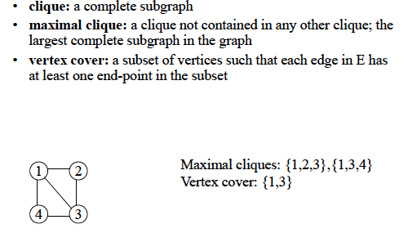
More definitions
Vertex cover is a famous problem in graph theory

Slide 36
Euler path vs. Hamiltonian path
Hamiltonian path = A path that passes through every vertex
exactly once. A closed path is a Hamiltonian circuit or cycle.
Euler path = A path that includes every edge exactly once.
A closed path is a Euler circuit or cycle.
We have reviewed Euler path in the 7-bridges of Konigsberg
Problem.

Slide 37
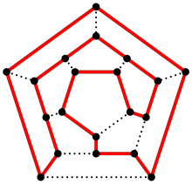
Hamiltonian path
1
2
5
4
3
Does the above graph have
a Hamiltonian cycle? No!
Hamiltonian circuit/cycle
colored red

Slide 38
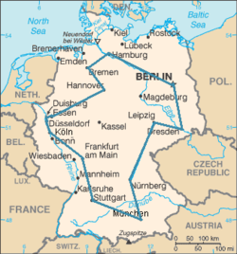
Traveling Salesman Problem (TSP)
A traveling salesman wants to visit each of n cities exactly once, and then return to the starting point. In which order should he
visit the cities to travel the minimum total distance?
TSP = Computing the minimum cost Hamiltonian circuit. TSP is an extremely complex problem to solve (NP-complete)
An optimal TSP tour through
Germany’s largest cities
(Source: Wikipedia)

Slide 39
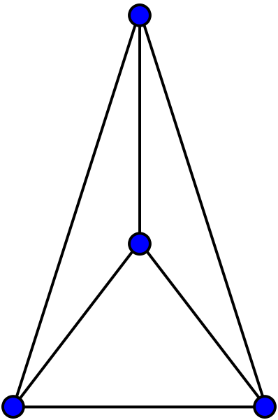
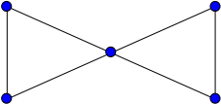
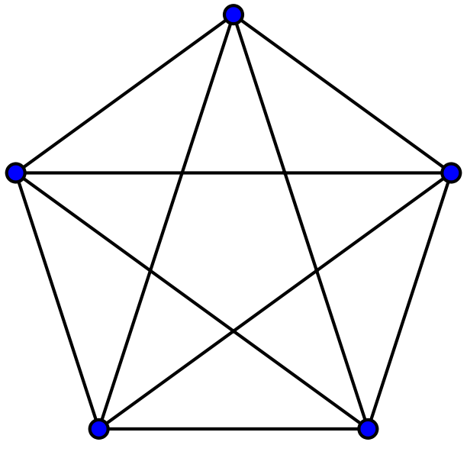

Planar Graph
A planar graph is one that can be embedded in the plane, i.e.,
it can be drawn on the plane in such a way that its edges do
not intersect except only at their endpoints.
planar
K₄
Butterfly
planar
Non-planar
Non-planar
K₅
K_{3,3}

